Slide 1
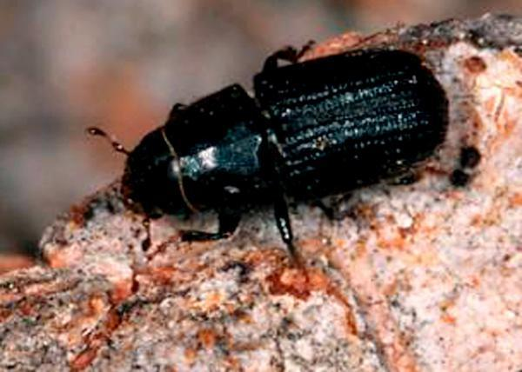
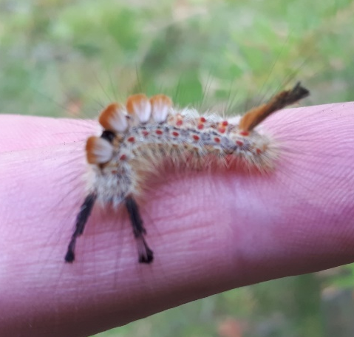
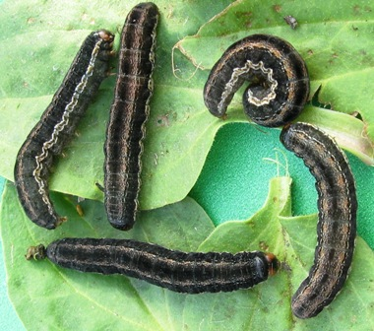
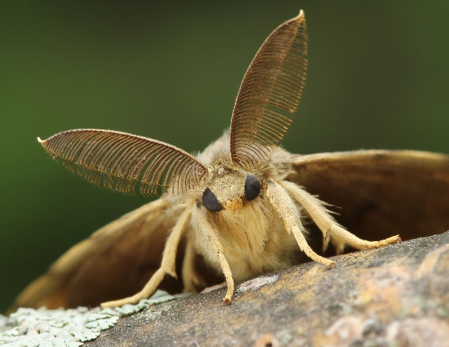
Update on Forest Health for RMT:
Kootenay Boundary Region
October 29, 2019
Marnie Duthie-Holt
Regional Entomologist

Slide 2
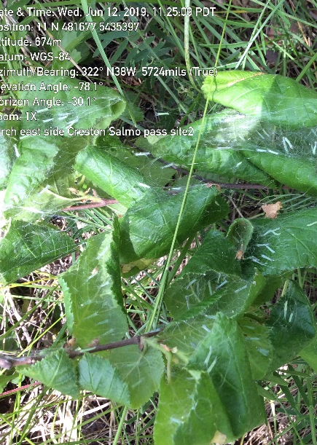
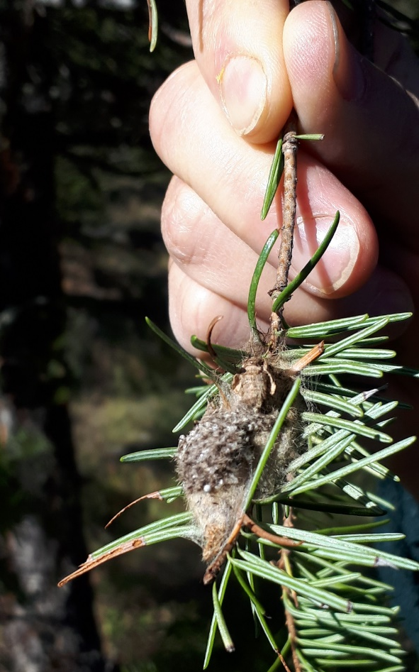
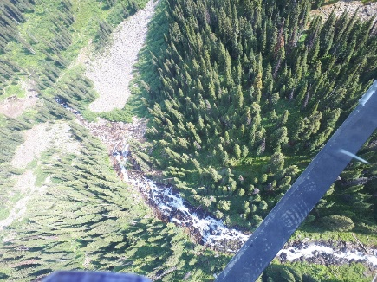
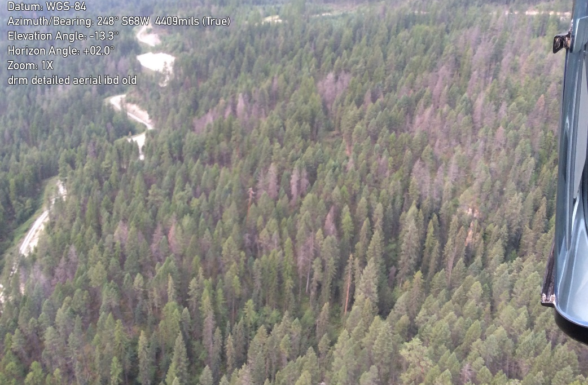
Overview
What services do Regional Forest Health Specialists provide?
Historical/ Current Trends
  Bark Beetles
  Defoliators
  Invasives

Slide 3
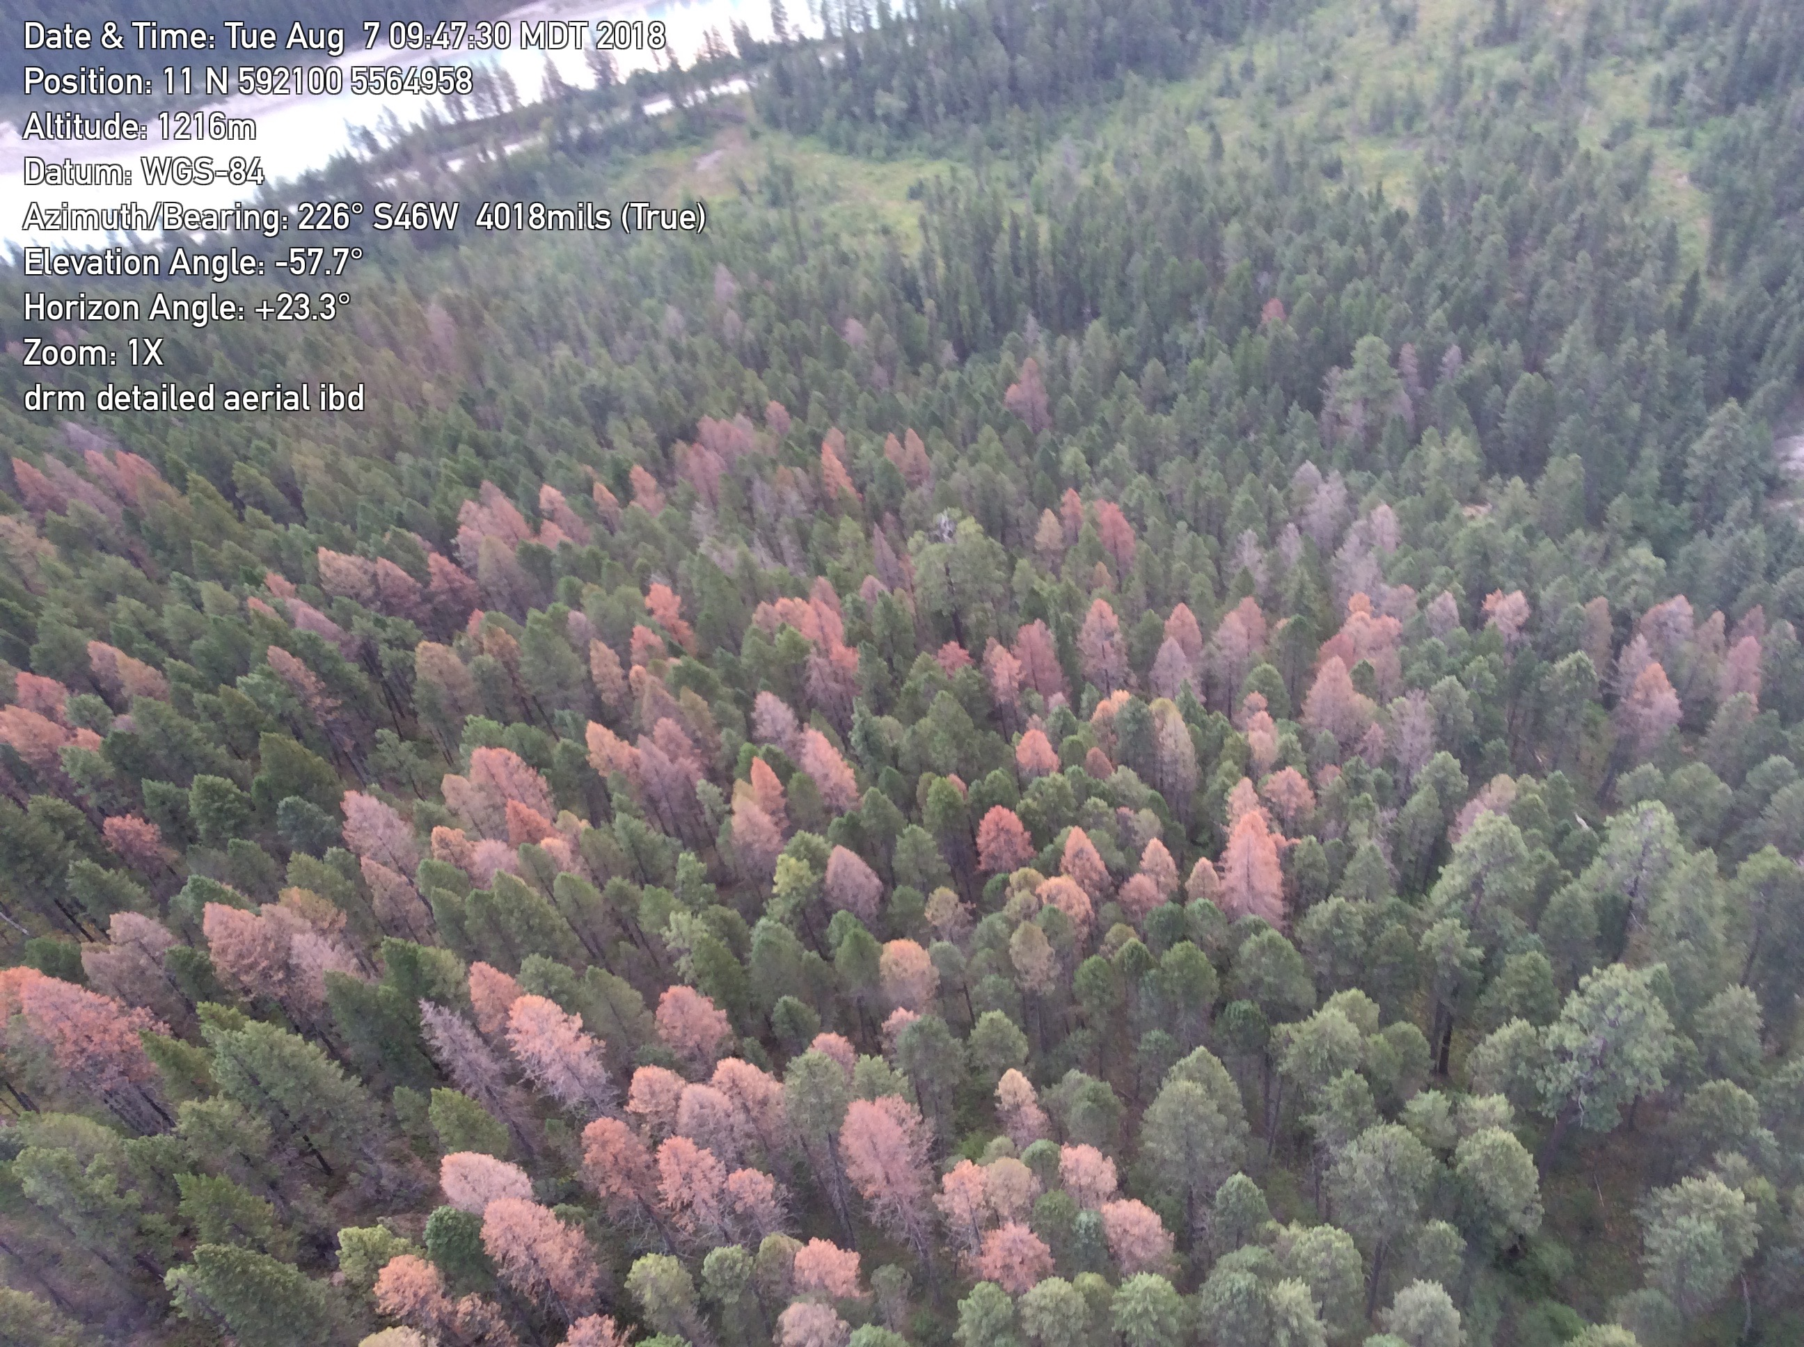
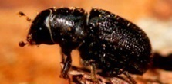
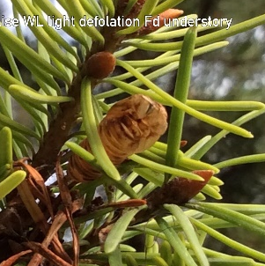
Regional Entomologist Role
Monitor local forest health conditions
Deliver operational programs
Gather and analyze forest health research data
Provide extension and expert consultative services to local decision makers, industry, and the public
Climate change will place an even greater emphasis on need for forest health monitoring and research

Slide 4
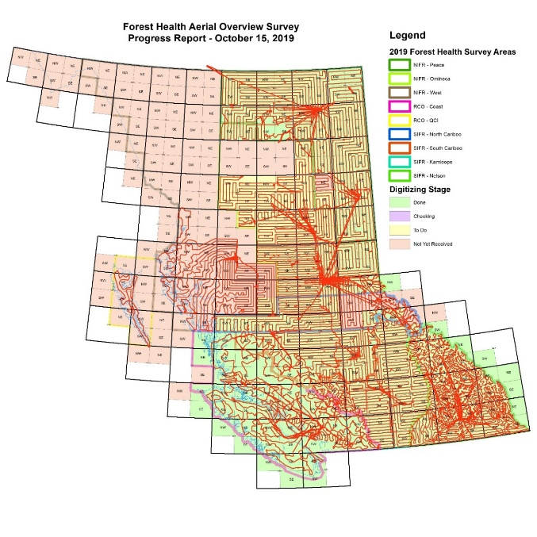
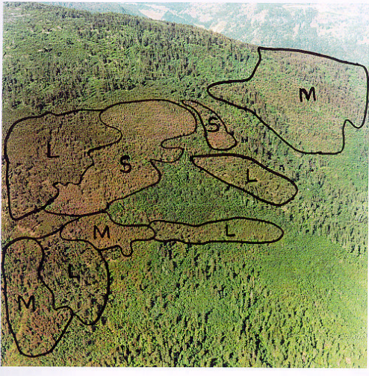
1. Monitor local FH conditions
Aerial Overview Surveys
  All biotic & abiotic factors
  Data 1920-present
Long term monitoring
Historical trends
Climate change impacts

Slide 5
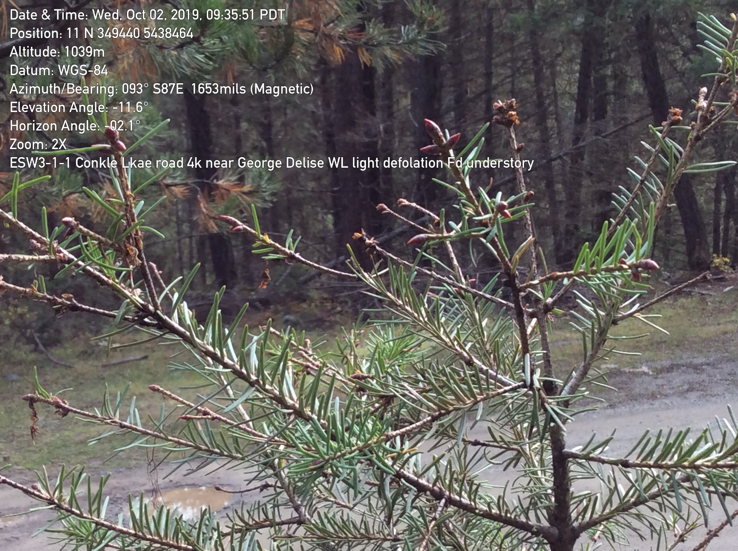
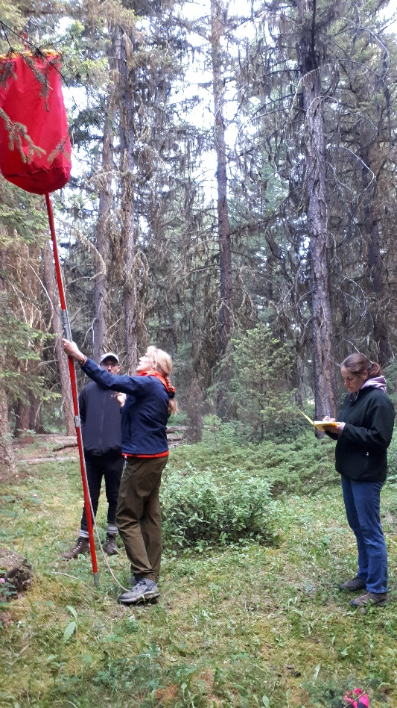
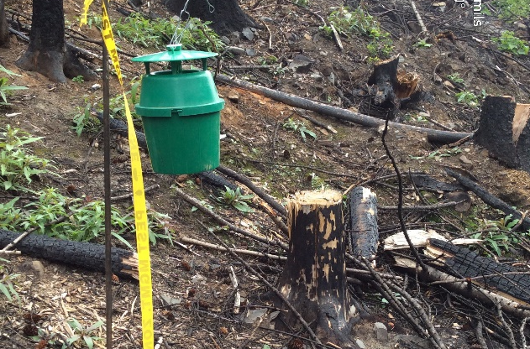
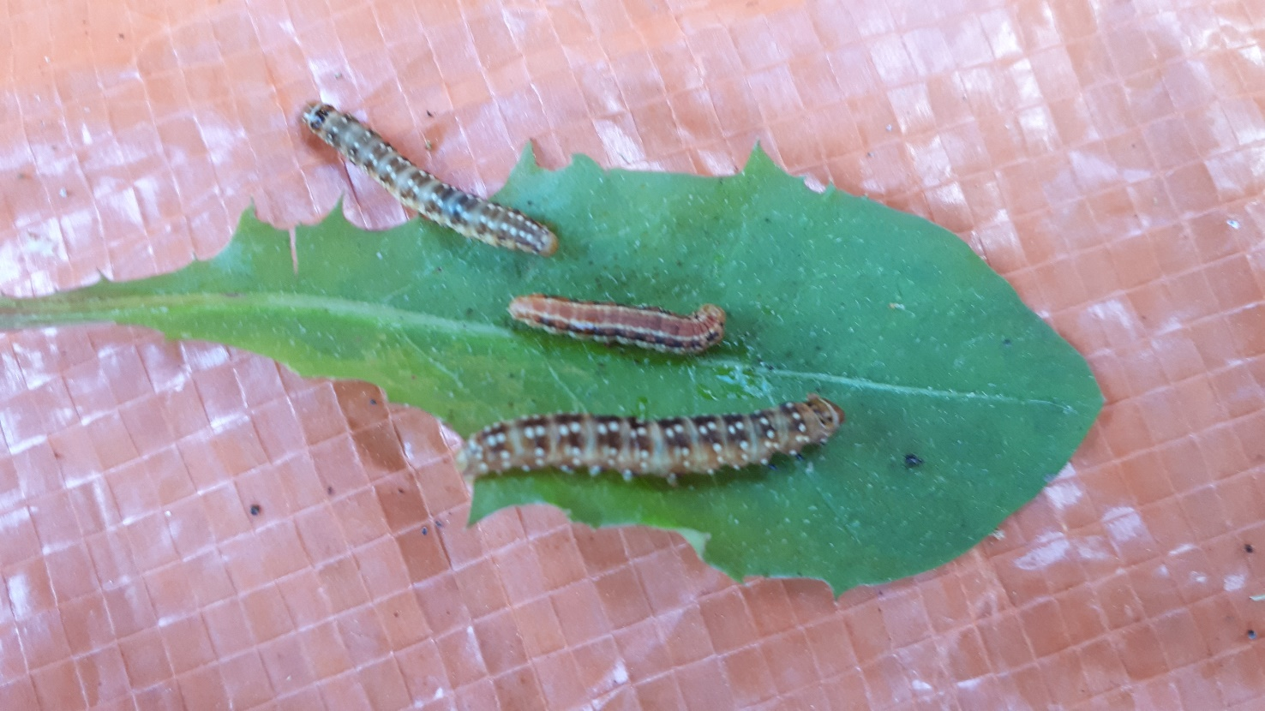
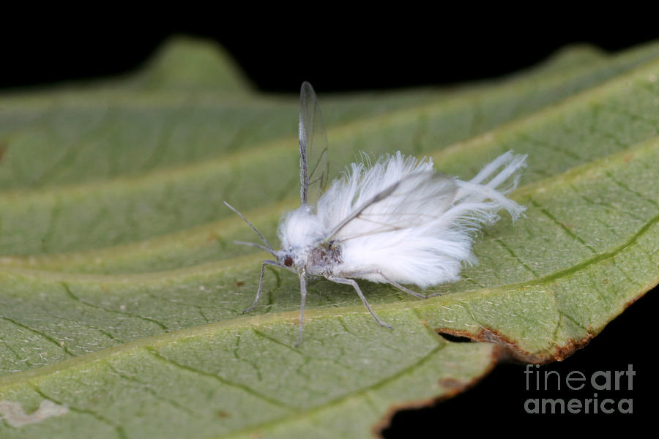
1. Monitor local FH conditions
Permanent Monitoring Sites
  Western spruce budworm
  Douglas-fir tussock moth
  Western hemlock looper
  2-year cycle budworm
Temporary Monitoring for emerging issues
  i.e. Black army cutworm
Invasive monitoring
  Gypsy moth
  Balsam woolly adelgid

Slide 6
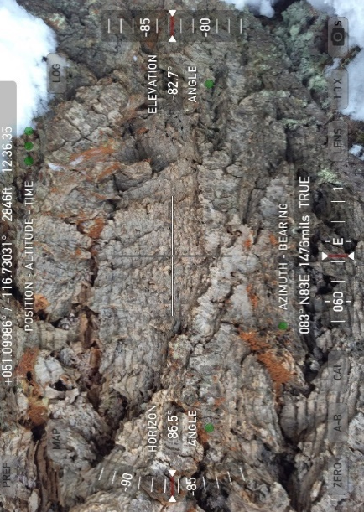
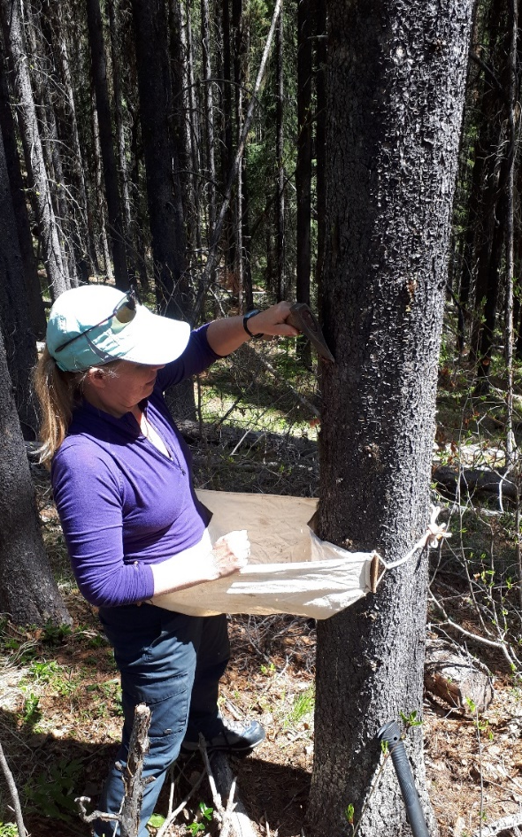
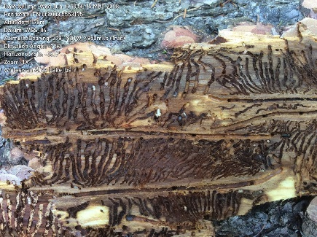
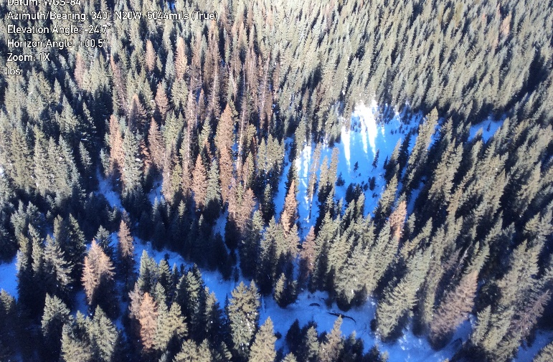
2. Deliver Operational Programs
Assist Districts with:
Forest Health Strategic Plans & Direction
  all 7 TSAs updated 2019/20
Bark Beetle Programs
  Align operations with Regional/ Provincial direction
  Contract standards
  Quality inspections
  Data storage and consistency
  Populations assessments

Slide 7
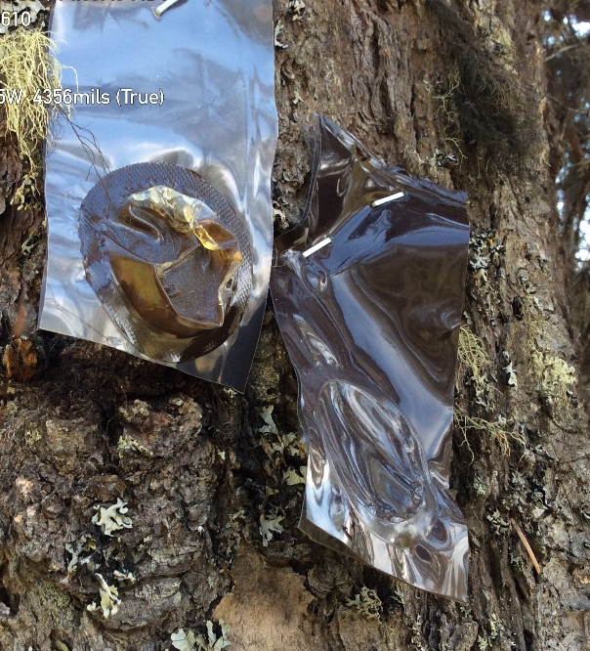
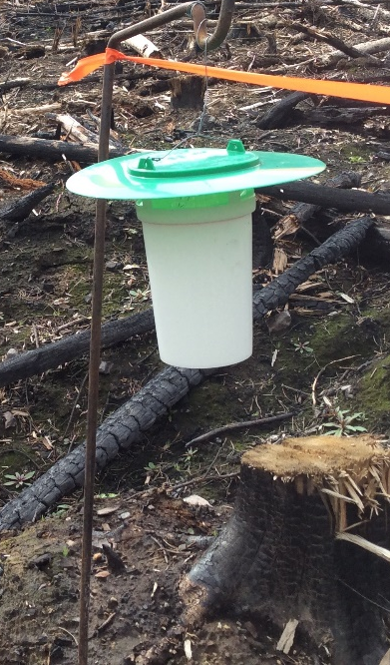
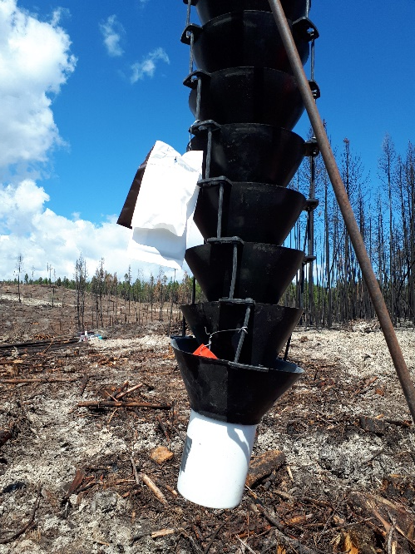
3. Gather and Analyze
Forest Health Research Data
Long term soil productivity & silviculture trials
Black army cutworm trap calibrations
Whitebark Retention research
Cumulative Effects Modelling
Caribou Pen assessment
Douglas-fir beetle – funnel trap lure improvements
Spruce bark beetle – repellent improvements
Western Red Cedar Decline
Drought and fire interactions with forest health agents
More….

Slide 8
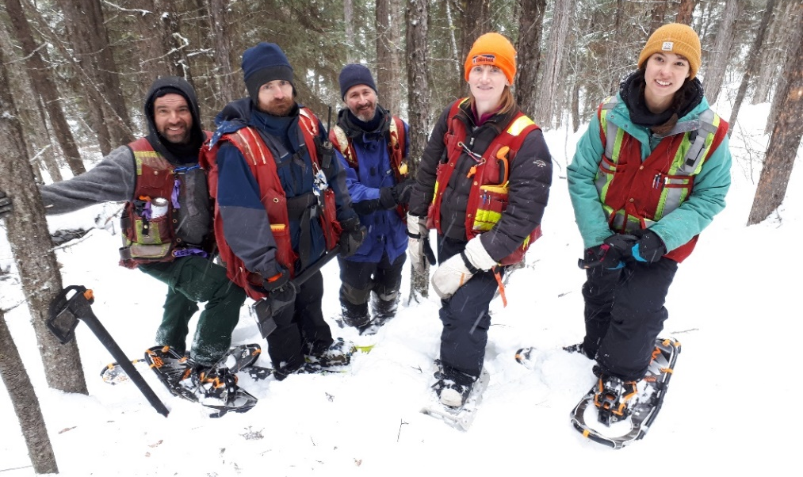
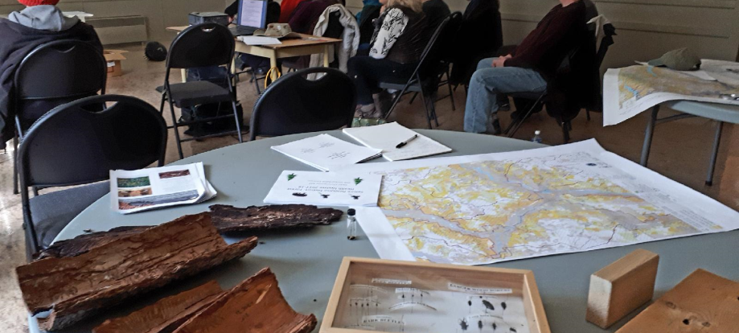
4. Provide extension and expert consultative services to local decision makers, industry, and the public
Training
  Districts, First Nations, licensees, Woodlots, contractors, BC and National Parks
  Formal courses offered in Cranbrook, Castlegar, Rock Creek, Golden, Revelstoke, Panorama, Nelson
Public info sessions
Licensee Open Houses
Field tours
Public site visits/ Pest ID

Slide 9
Drought
ha
Boundary TSA – heaviest hit

Slide 10
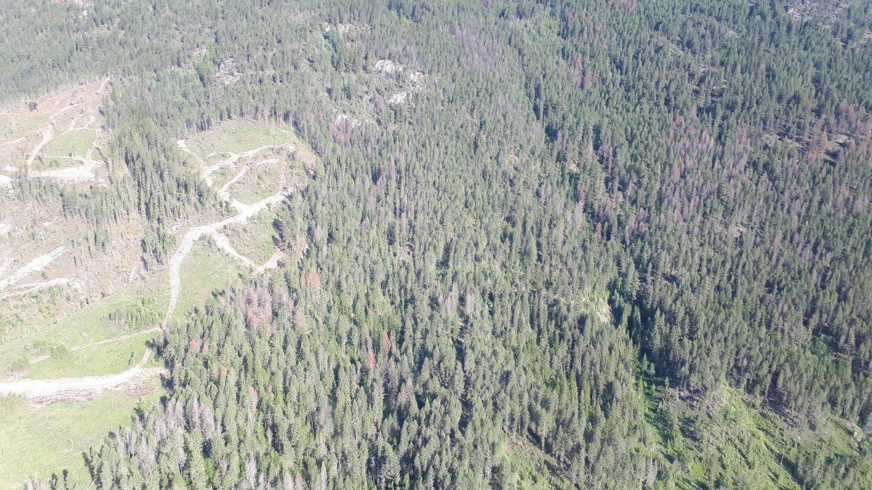
Drought
“Hot droughts” (low precipitation in combination with high temperatures)
direct impacts on tree physiology such as
  reduced growth,
  crown die­‐back, and
  mortality;
or indirect impacts such decreased resistance to insect and disease attack, resulting in mortality
Bark beetles, engraver beetles, and weevils are particularly sensitive to drought conditions with populations increasing!

Slide 11
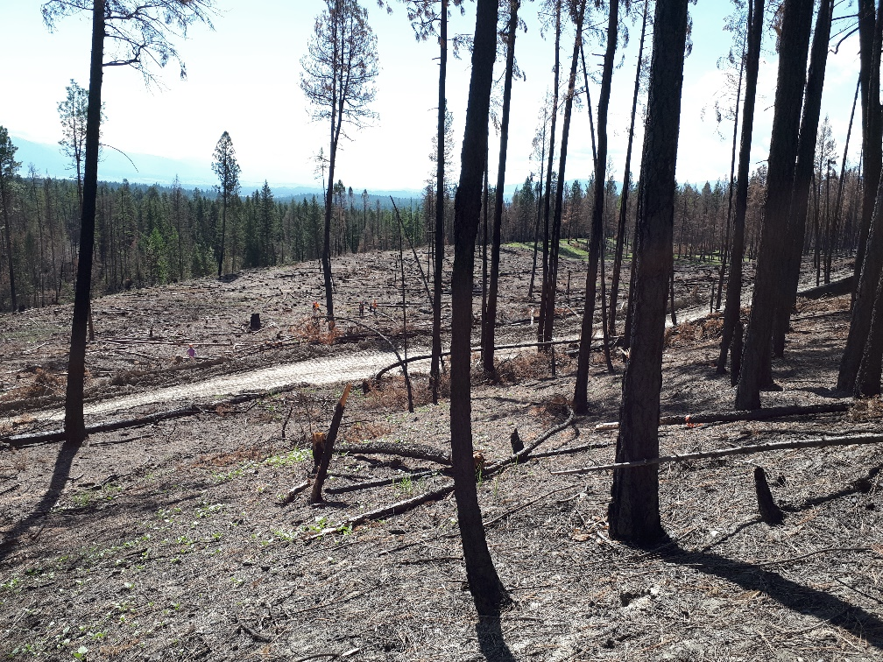
Historical trends & current issues
Douglas-fir Beetle
Arrow & Invermere
ha
Most emerging issue (drought, fires, constraints)

Slide 12
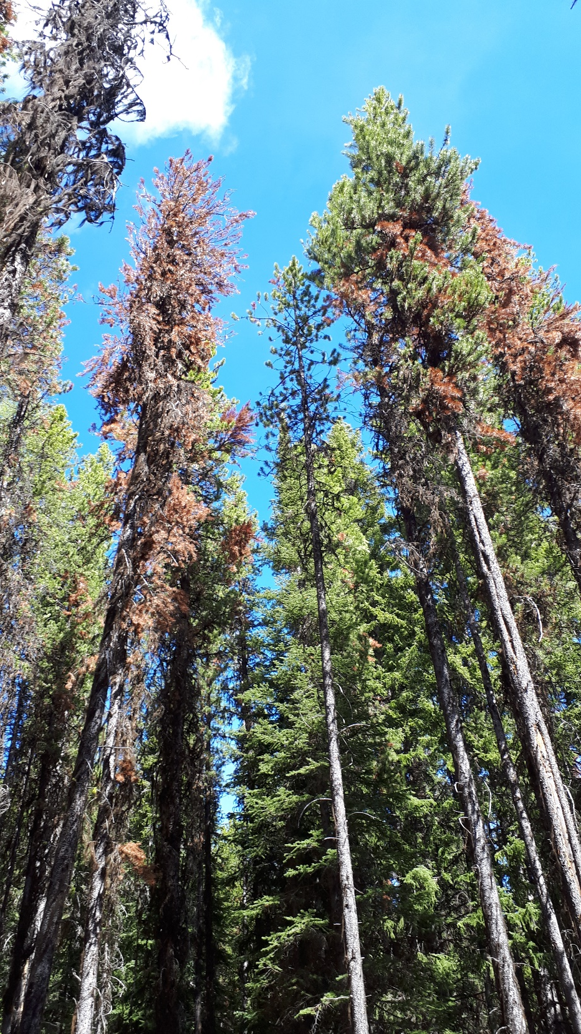
Historical trends & current issues
Mountain Pine Beetle
Next wave is coming…..attacking smaller diameter trees previously effected by drought

Slide 13
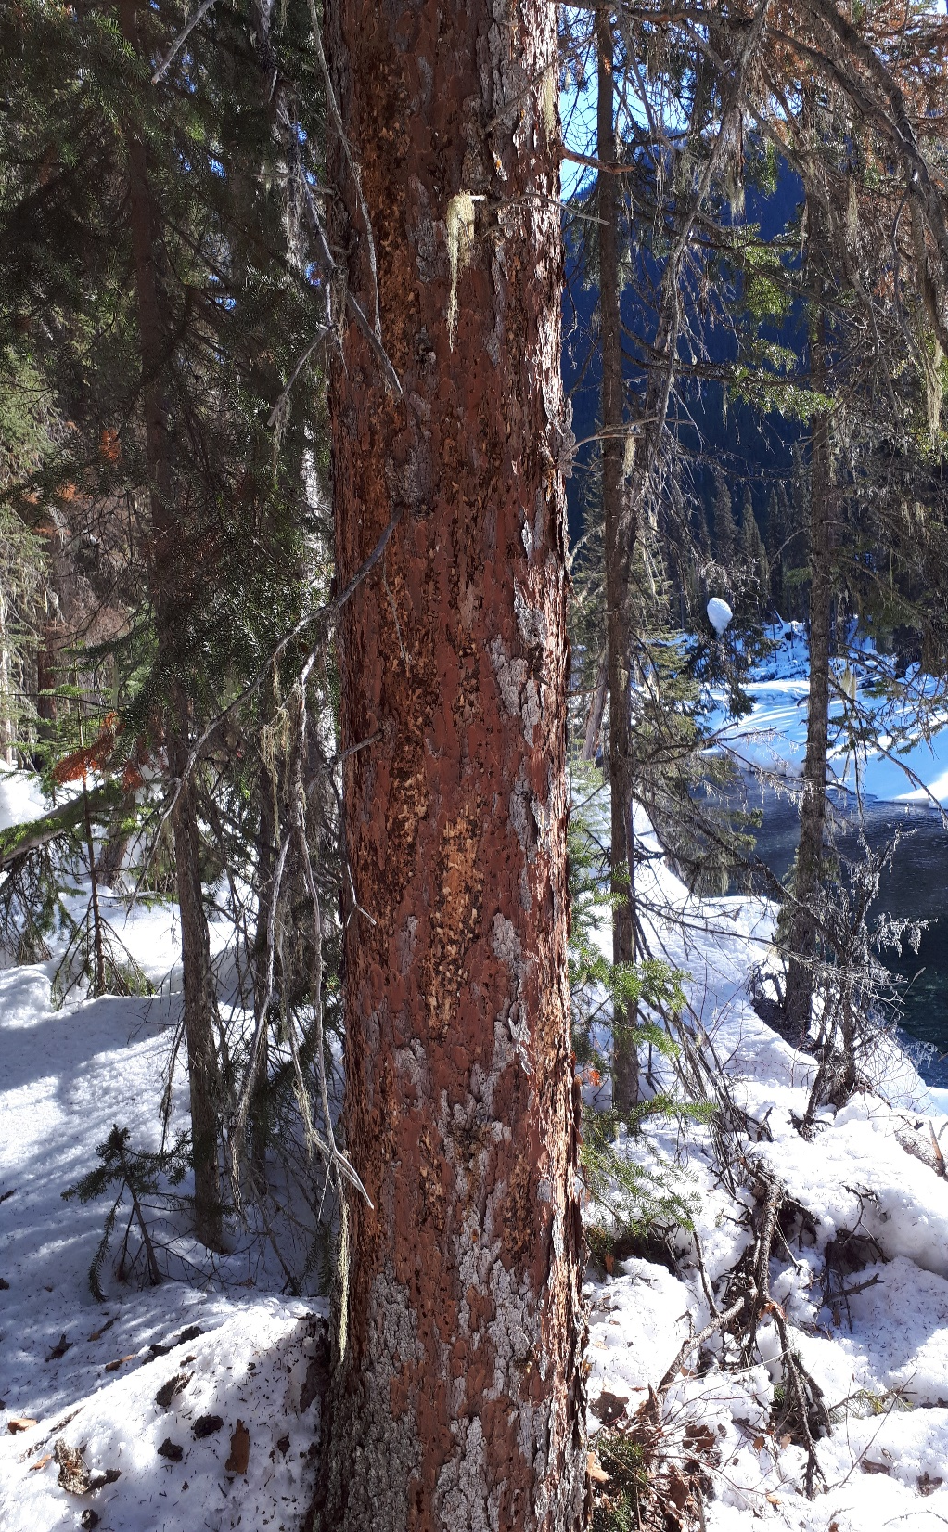
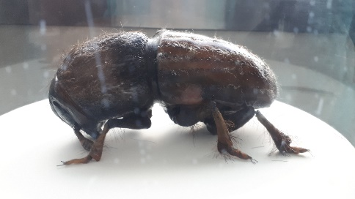
Historical trends & current issues
Spruce Beetle
2013 Floods – Invermere/ Cranbrook
Palliser/ Elk Valley

Slide 14
Historical trends & current issues
Western Balsam Bark Beetle
KBR ha total | 2019 | Last 10 years
IBB | 100,000 | 316,000
IBM | 25,000 | 407,400
IBS | 20,000 | 65,000
IBD | 12,000 | 40,000

Slide 15
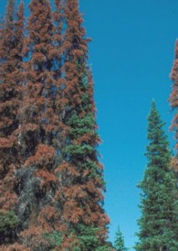
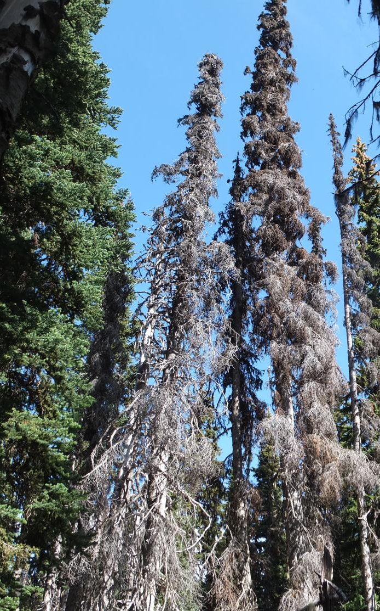
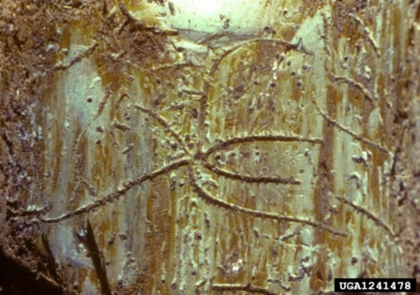
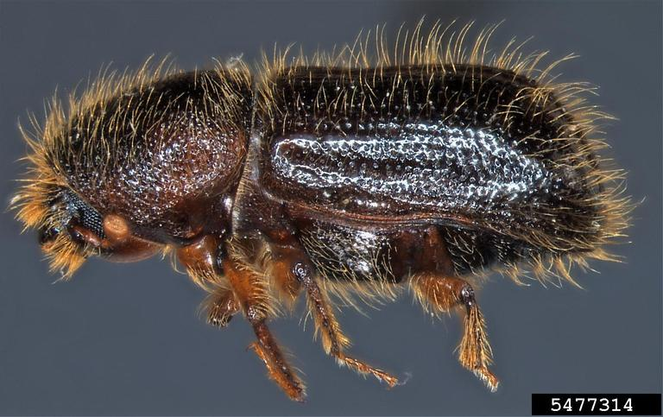
Western balsam bark beetle
Attack rates are accelerating
Very little Bl is being salvaged, therefore few impacted stands rehabilated
Climate change repercussions in these high elevation forest much more drastic

Slide 16
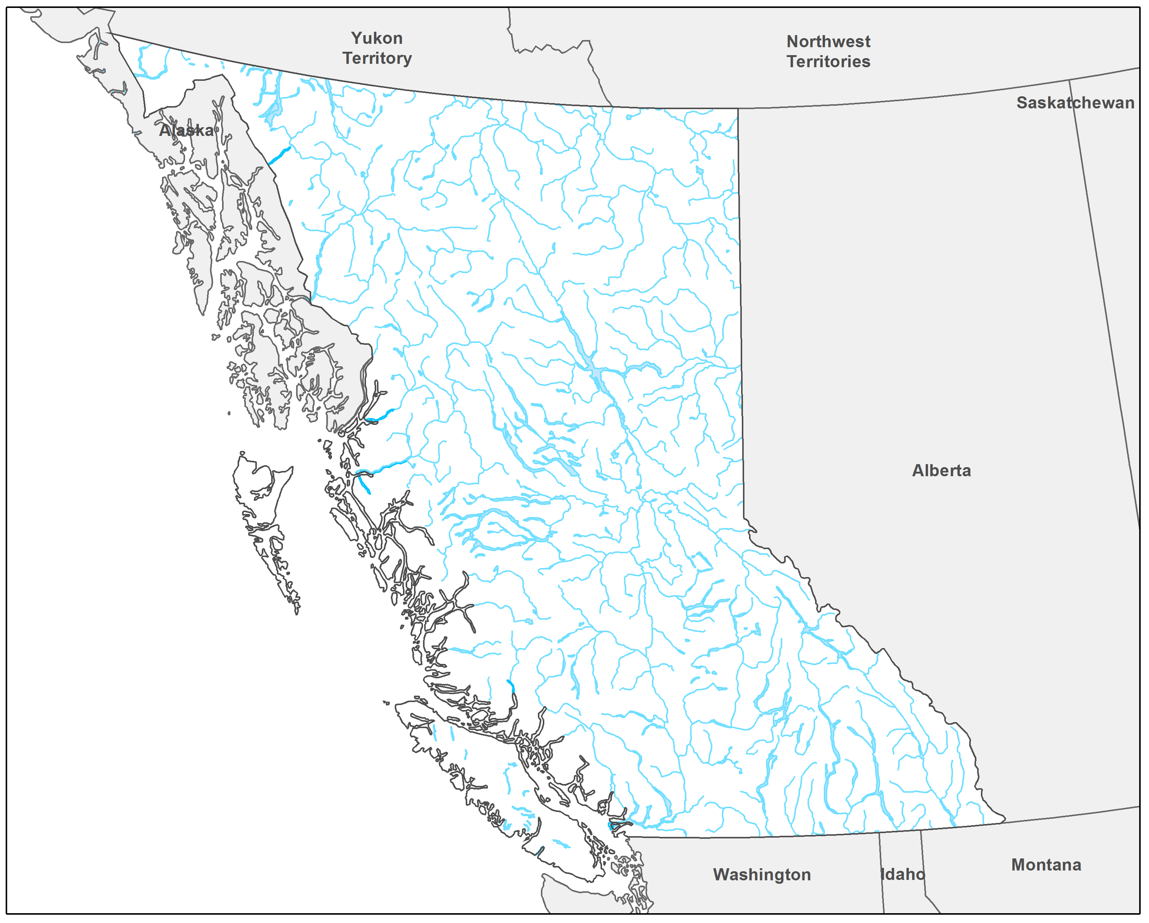
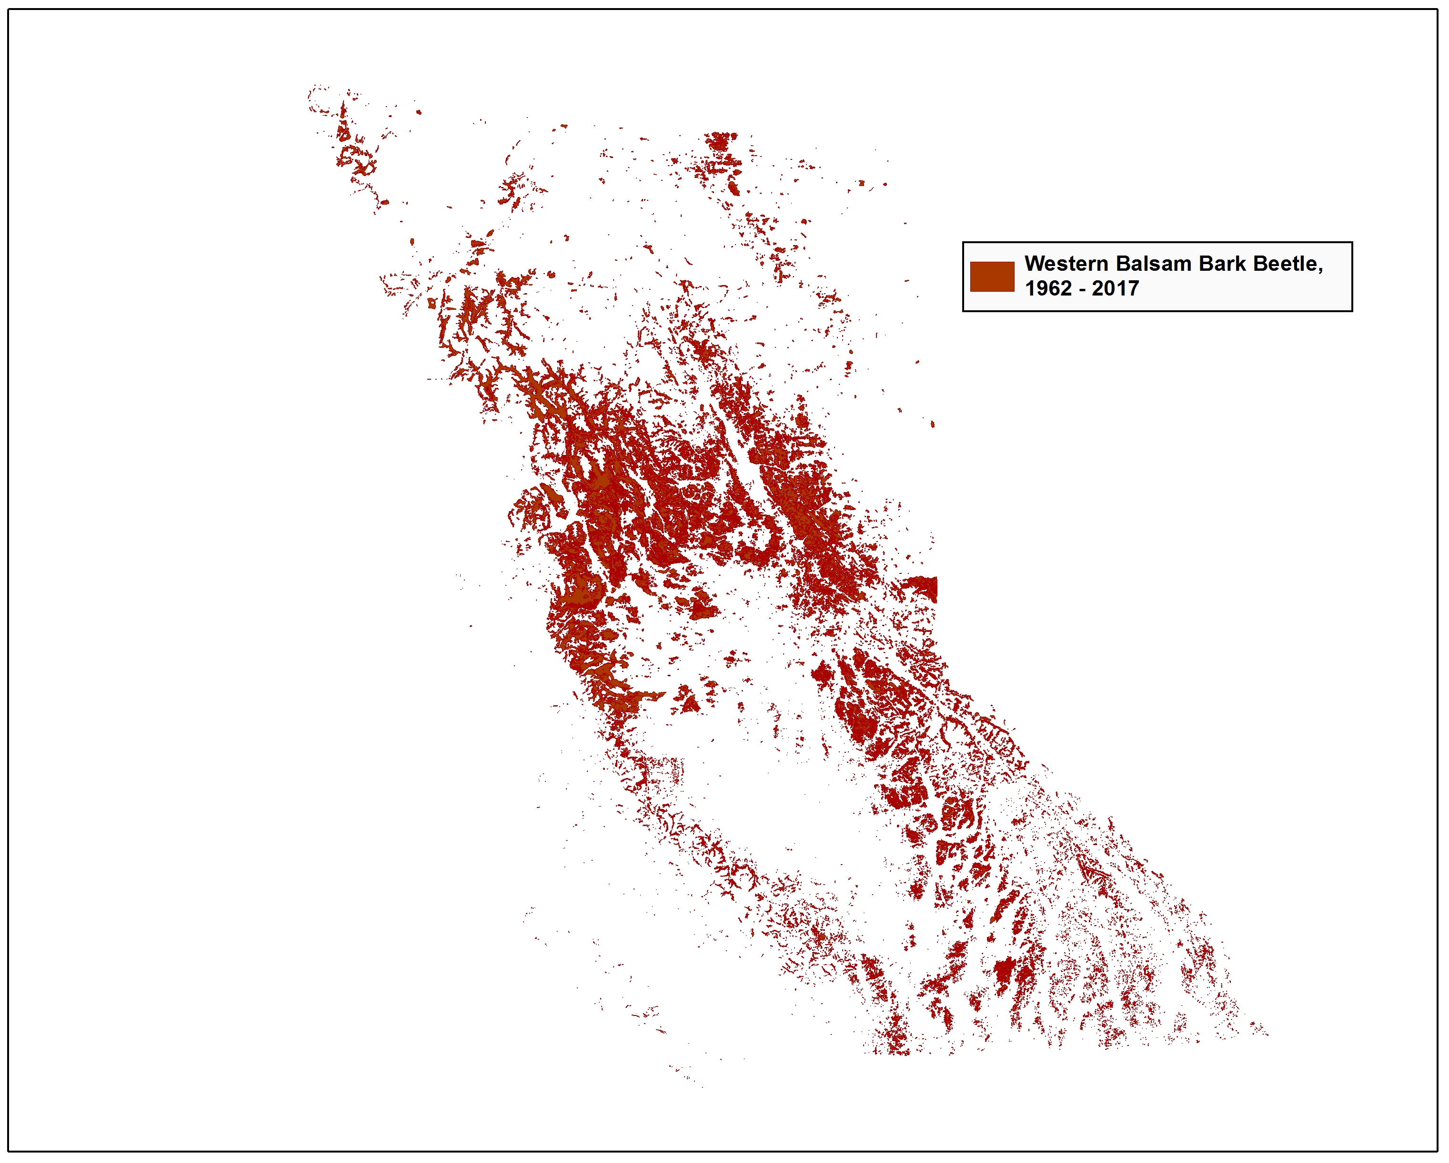
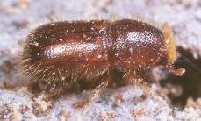

Slide 17
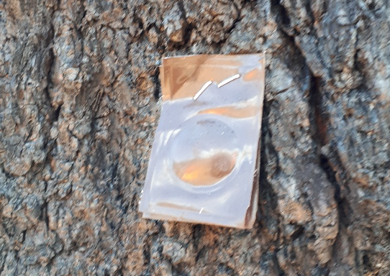
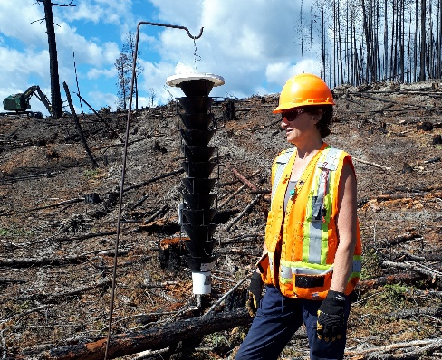
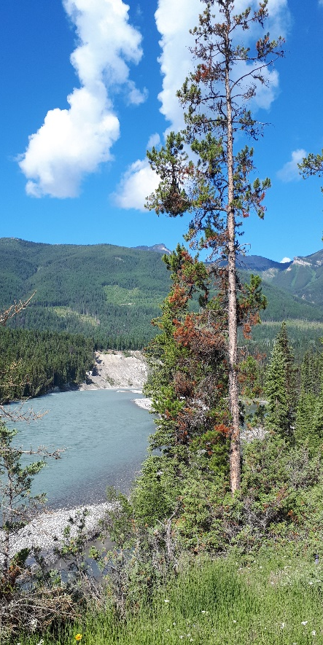
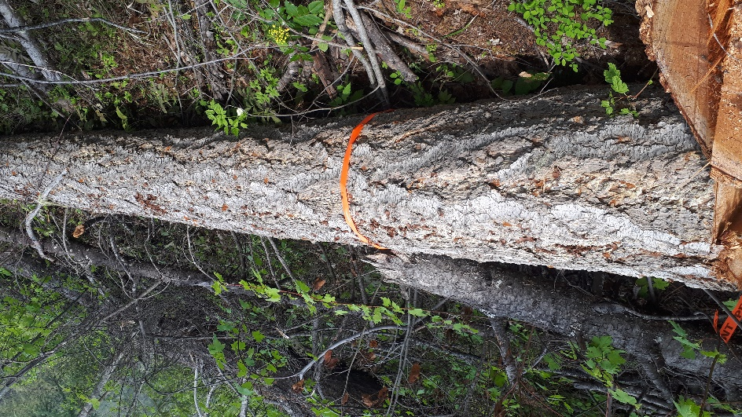
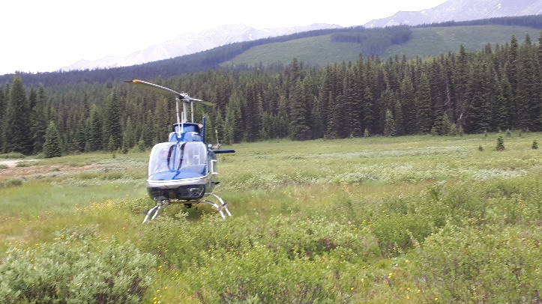
Bark Beetle Program Summaries
2019-2020 Estimates
Activity | DSE | DRM | KBR Total
Detailed aerial survey (ha) | 539,750 | 524,603 | 1,064,353
Ground surveys (sites) | 267 | 455 | 722
Funnel trapping (sites) | 150 | 76 | 226
Trap trees (#s) | 20 | 733 | 753
Fall and burn (trees) | 320 | 2,483 | 2,803
MCH | 1,230 | 0 | 1,230

Slide 18
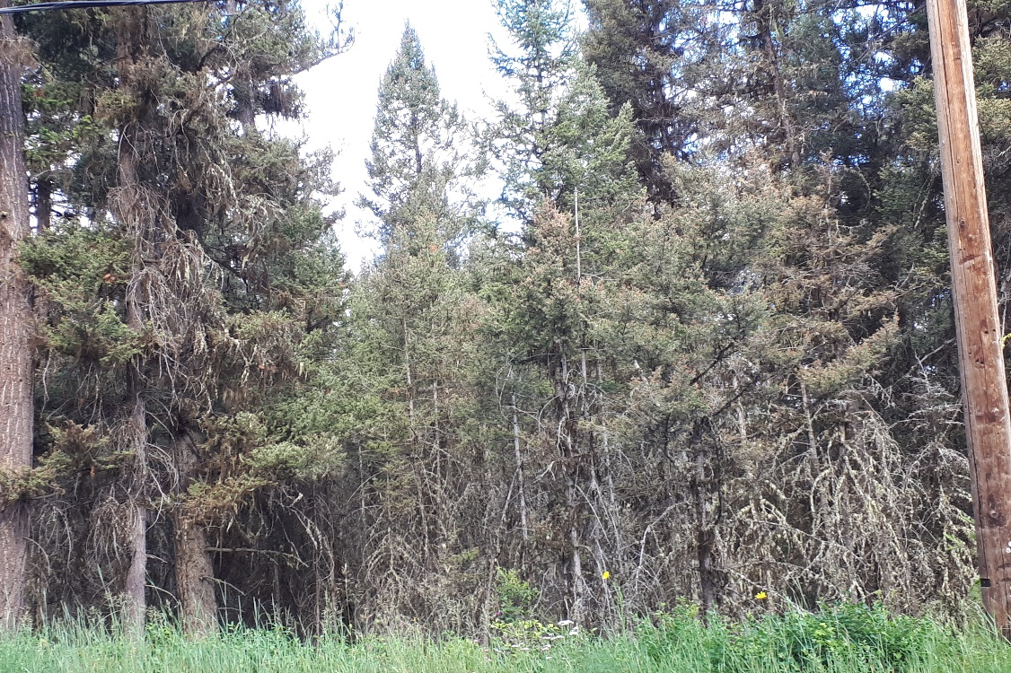
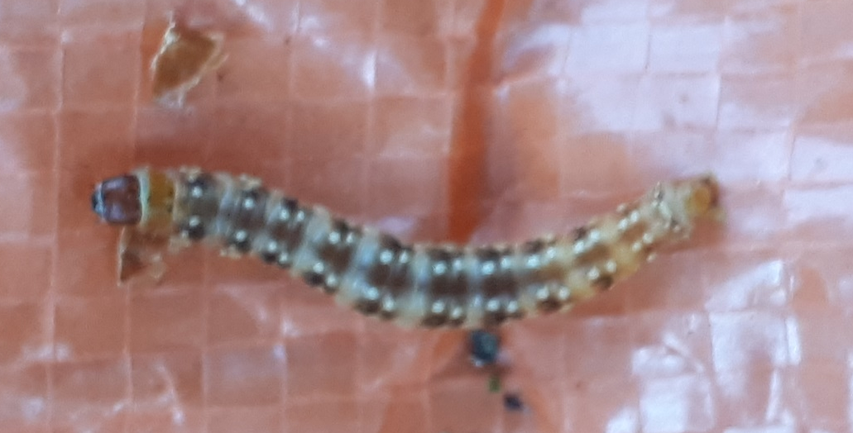
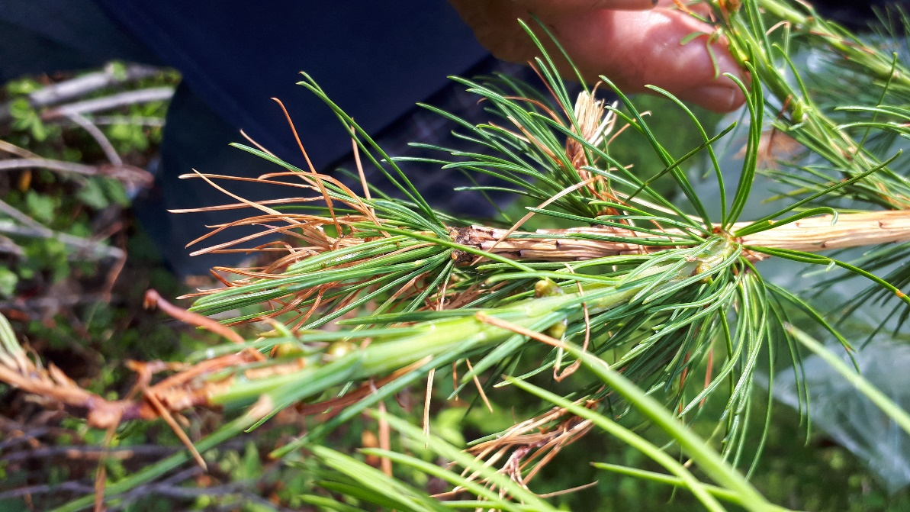
Western Spruce Budworm
  Reduces incremental growth, kills tree after multiple years
  Understory most effected
  TOR and CAR Spraying in 2020
  Numbers still too low to spray in KBR, will continue to monitor

Slide 19
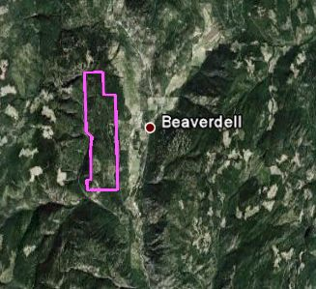
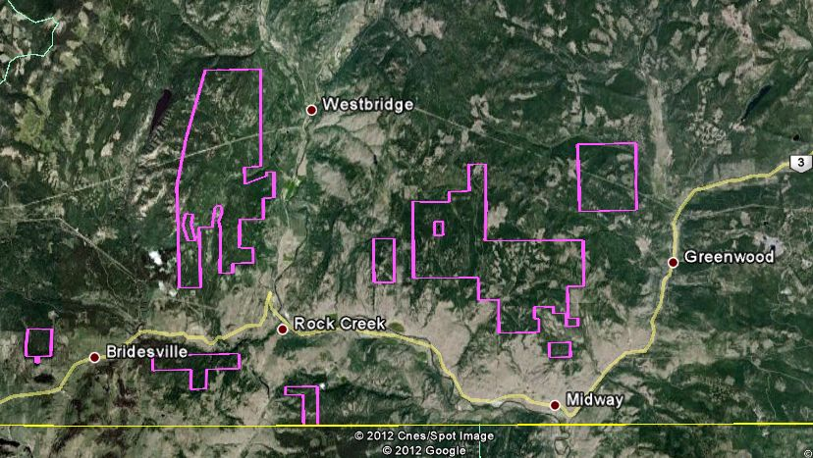
Western Spruce Budworm
  Last spray 2012

Slide 20

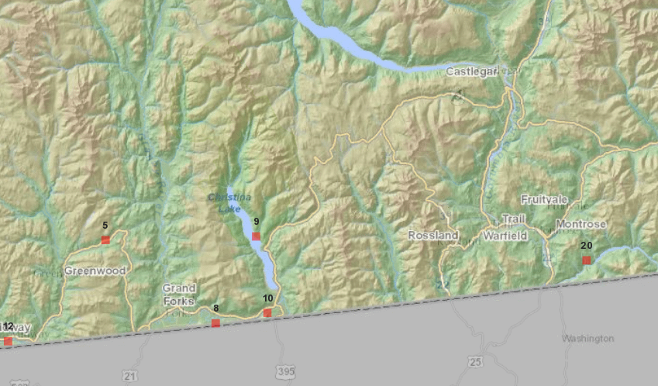

Douglas-fir tussock moth
Populations slightly increasing near Rock Creek, east to Greenwood, and in Midway (Boundary)
On private land
Kills trees in single year
Health concerns –allergic reaction
Will continue to monitor

Slide 21



Western Hemlock Looper
  Can kill hemlock 1-2 years; approximately 20 year cycle
  Populations increasing
    larvae found in 24/25 sites; 3 fold increase
    Adult trap catches – 4 fold increase
  2012 sprayed Btk for protection of Caribou habitat north Revelstoke
  Will continue to monitor

Slide 22




Gypsy Moth
One of 100 most destructive invasive species worldwide
One of most destructive pests of hardwood trees in E USA
Host includes 500 species of trees, shrubs and plants
BCs highest priority for forest health funding; International trade and export controls require eradication
2020 Btk spray areas: Surrey, Campbell River and Castlegar

Slide 23
KBR 2019/2020
Bark Beetle Funding Actual (Request)
 | IBM | IBD/IBS | Total
DSE | $115,000.00 ($156,000.00) | $288,000.00 ($269,000.00) | $403,000.00 ($425,000.00)
DRM | $385,775.00 ($380,870.37) | $493,225.00 ($565,129.63) | $879,000.00 ($946,000.00)
KBR | $15,000.00 | $14,000.00 | $29,000.00
Total | $515,775.00 | $795,225.00 | $1,311,000.00

Slide 24
KBR 2019/2020
Bark Beetle Funding Actual (Request)
 | IBM | IBD/IBS | Total
DSE | $115,000.00 ($156,000.00) | $288,000.00 ($269,000.00) | $403,000.00 ($425,000.00)
DRM | $385,775.00 ($380,870.37) | $493,225.00 ($565,129.63) | $879,000.00 ($946,000.00)
KBR | $15,000.00 | $14,000.00 | $29,000.00
Total | $515,775.00 | $795,225.00 | $1,311,000.00
Total Provincial Forest Health Budget
$6.035M
Plus $212,000 outside of bark beetles

Slide 25
2020/2021 Draft Budget Asks
 | Gypsy moth | AOS | SB/DFB | MBP | WSBW | FH Strategy Updates | Monitor | Total
DSE |  |  | $240,000 | $165,000 |  |  |  | $405,000
DRM |  |  | $581,513 | $392,345 |  | $5,000 |  | $978,858
KBR | $8,000 | $189,500 | $15,000 | $14,000 | $8,000 |  | $6,500 | $241,000
Total | $8,000 | $189,500 | $836,513 | $571,345 | $8,000 | $5,000 | $6,500 | $1,624,858

Slide 26
Provincial Direction
“Fiber is where the current focus is… amount and quality, who has it and who wants it” Deputy Minister John Allan
Bark beetles effect more fiber yearly than fires or any other net down factor
Defoliators also reduce fiber and predispose trees to other mortality agents if they do not outright kill the tree themselves

Slide 27



Goal: Healthy, resilient forests
Goal:
Healthy, Resilient Forests, through
Pro-Active Management

